Slide 1
Sections 2.4-2.5 Acceleration and Free Fall

Slide 2
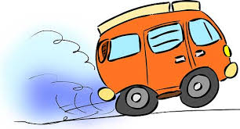
Acceleration
Acceleration is the change in velocity over time

Slide 3
Formula
Acceleration = change in velocity
in symbols, a = ∆v
time
t

Slide 4
Units of Acceleration
Since acceleration is a velocity divided by a time, its units are a distance unit divided by 2 time units.
Example:
m/s/s = m/s²

Slide 5
Rearranging the Formula

Slide 6
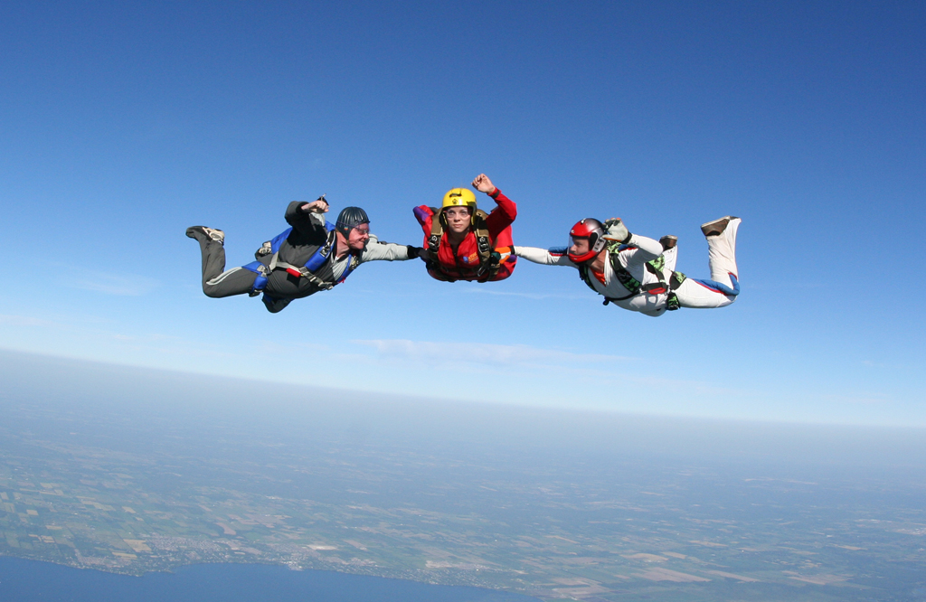
Free Fall
Free fall is motion under the influence of gravity
Gravity is a force that attracts an object towards the center of Earth or towards another object

Slide 7
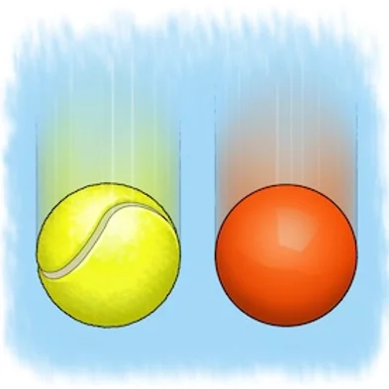
Acceleration in Free Fall
The acceleration of an object in free fall is constant.
g = 9.8 m/s².

Slide 8
Air Resistance
The effect of air resistance is to slow an object down
Air resistance of heavier objects is negligible (we will look at lighter objects in a future unit)

Slide 9
Formulas
v = g t when solving for velocity
h = ½ g t² when solving for height/displacement
­t = √$\frac{2h}{g}$ when solving for time

